Slide 1


“Jai Sri Gurudev” S J C INSTITUTE OF TECHNOLOGY DEPARTMENT OF INFORMATION SCIENCE AND ENGINEERING
TECHNICAL SEMINAR
On
“Cough-based deep learning framework for detecting COVID-19”
PRESENTED BY
RAKSHITHA H G 1SJ19IS128
Technical Seminar Coordinator: Under the Guidance of:
Dr. Vijay G R Ambika L G
Associate Proffesor Assistant Proffesor
Department of ISE Department of ISE

Slide 2
CONTENTS
Cough-based deep learning framework for detecting COVID-19
INTRODUCTION
LITERATURE REVIEW
MODEL IMPLEMENTATION
METHODOLOGY
PERFORMANCE EVALUATION METRICS
RESULTS
CONCLUSION
REFERENCES

Slide 3
INTRODUCTION
Cough-based deep learning framework for detecting COVID-19
My topics presents a deep learning framework for detecting COVID-19 positive subjects from their cough sounds.
The COVID-19 pandemic has deeply impacted the global health systems with a rising number of 231 million cases and a high death toll of 4.7 million. . It is now spanning across 200 countries quickly.
Effective solutions for COVID-19 testing on a massive scale for control the enormous impacts of the current epidemic. Indeed, if COVID-19 positive cases can be early detected, it is very useful for self-observation, isolation, and effective treatment methods.
Focusing on the cough sound, recent researchers show that it is potential to detect COVID-19 through evaluating coughing.

Slide 4
LITERATURE REVIEW
Cough-based deep learning framework for detecting COVID-19
PP No. | Paper Name | Author Name | Year | Advantages | Disadvantages
1 | The second dicova challenge: Dataset, task, and baseline system for covid-19 diagnosis using acoustics | N. K. Sharma, S. R. Chetupalli, D.Bhattacharya, D. Dutta, S. Ganapathy, | 2021 | The results suggest the suitability of fusing breath and speech information to detect COVID-19. | difﬁcult understanding if the performance of the network is conditioned by the patient’s gender.
2 | Exploring automatic covid-19 diagnosis via voice and symptoms from crowd sourced data | J. Han, C.Brown, Chauhan, A. Grammenos, D. Spathis, T. Xia, | 2021 | rapid, low-cost, and convenient tool for automatically detect the disease. | Fails distinguish the voice of symptomatic infected and non infected COVID=19 patecents

Slide 5
LITERATURE REVIEW
Cough-based deep learning framework for detecting COVID-19
PP No. | Paper Name | Author Name | Year | Advantages | Disadvantages
3 | Covid-19 diagnosis from cough acoustics using convnets and data augmentation | S. K. Mahanta, D. Kaushik, S. Jain, H. Van Truong, K. Guha | 2021 | its gives accurate prediction | the setup for testing is both time and cost- consuming
4 | Recognising covid-19 from coughing using ensembles of svms and lstms with handcrafted and deep audio features | V. Karas B. W. Schuller | 2021 | MPL neural network shown a high performance with accuracy 93% for detecting | processing time is high

Slide 6
MODEL IMPLEMENTATION
Cough-based deep learning framework for detecting COVID-19
1. Dataset
The Second 2021 DiCOVA Challenge uses a subset of the Coswara dataset collected between April 2020 and July 2021 from the age group of 15 to 90.
The challenge provides a dataset of different sound signals: cough, speech, and breathing gathered from both COVID-19 positive and non-COVID-19 individuals.
The dataset provides a Development set of 965 audio recordings and a Blind Test set of 471 audio recordings. All audio recordings of cough sounds are not less than 500 milliseconds and recorded with different sample rates.
The ‘Area under the ROC curve’ (AUC) is used as the primary evaluation metric in the Second 2021 DiCOVA Challenge.

Slide 7
2. Architecture of Deep Learning Framework2
Cough-based deep learning framework for detecting COVID-19
High-level architecture
The audio recordings show different sample rates, they are firstly re-sampled to 44.1 kHz using a mono channel. Then, the re-sampled recordings are inputted into the frontend feature extraction.
This uses SVM algorithm to detect neighbor samples is applied on the combined features to make sure the equal number of positive and negative samples.
Finally the combined features fed into different back-end classification models for detecting COVID-19 positive cases.

Slide 8
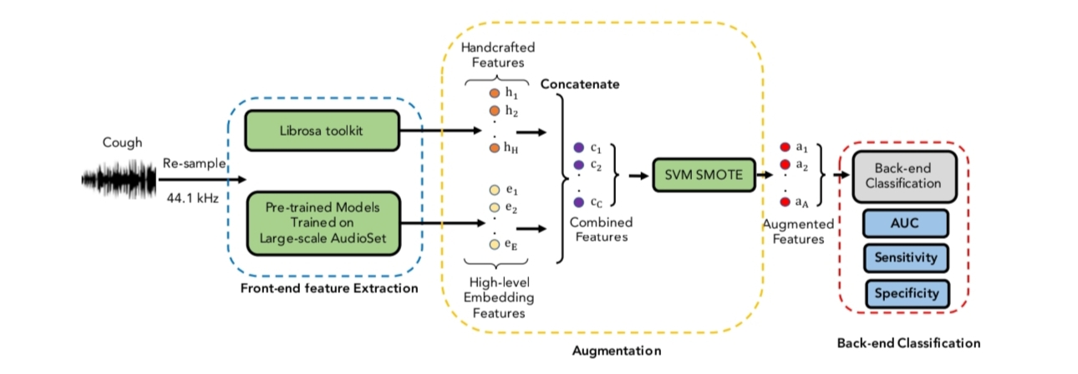
Cough-based deep learning framework for detecting COVID-19
Fig. 1. The high-level architecture of deep learning framework proposed.

Slide 9
zz
Cough-based deep learning framework for detecting COVID-19
3. The front-end feature extraction
In this step, we propose a method to create combined features by combining handcrafted features and embeddingbased features extracted from pre-trained models for COVID detection.
These handcrafted features are used as they are popularly adopted in speech processing and show robustness in the First 2021 DiCOVA Challenge.
4 .The back-end classification model
In this paper, we evaluate different back-end classification models: Light Gradient Boosting Machine (LightGBM), Random Forrest (RF), Support Vector Machine (SVM), Multi-layer Perceptron (MLP), and Extra Tree Classifier (ETC).
To obtain results, each classification model is run with 10 seeds numbered from 0 to 9.

Slide 10
METHODOLOGY
Cough-based deep learning framework for detecting COVID-19
1. Performance comparison across different features
To evaluate different features extracted, we keep the backend classification model of LightGBM unchanged while replacing different input features: Handcrafted feature, YAMNet based embedding, COMPARE 2016 based embedding, Wave2Vec based embedding, TRILL based embedding, handcrafted & YAMNet, handcrafted & COMPARE 2016, handcrafted & Wave2Vec, and handcrafted & TRILL features.
The best performance is obtained from the combination of the handcrafted feature and TRILL-based embedding feature, achieving the AUC, Sens., and Spec. scores of 81.21, 48.33, and 95.13 respectively on Blind Test set.

Slide 11
METHODOLOGY
Cough-based deep learning framework for detecting COVID-19
2. Performance comparison across different classification model
We keep the handcrafted & TRILLbased embedding feature unchanged while replacing LightGBM by different back-end classification models of Support Vector Machine (SVM), Random Forest (RF), Extra Trees Classifier (ETC), and Multi-layer perceptron (MLP).
The combination of the handcrafted feature and TRILL-based embedding feature for the front-end feature extraction and LightGBM for backend classification, we conducted 10 times of running the experiments on five folds of Development set.

Slide 12
METHODOLOGY
Cough-based deep learning framework for detecting COVID-19
3. Performance comparison across the top-10 systems submitted for the dataset of the Second 2021 DiCOVA Challenge
To compare the state-of-the-art systems, we joined the Second 2021 DiCOVA Challenge, submitted our proposed system, and compared with the other submissions.
Despite the sense of high AUC, it is important to to evaluate the suitably calibrated probabilities due to the nature of COVID-19 screening and imbalanced dataset.

Slide 13
METHODOLOGY
Cough-based deep learning framework for detecting COVID-19
RESULTS
This paper presents a deep learning framework for detecting COVID-19 positive subjects from their cough sounds. In particular, the proposed approach comprises two main steps.
In the first step, we generate a feature representing the cough sound by combining an embedding extracted from a pre-trained model and handcrafted features extracted from draw audio recording, referred to as the front-end feature extraction.
Then, the combined features are fed into different back-end classification models for detecting COVID-19 positive subjects in the second step.
Our experiments on the Track-2 dataset of the Second 2021 DiCOVA Challenge achieved the second top ranking with an AUC score of 81.21 and the top F1 score of 53.21 on a Blind Test set, improving the challenge baseline by 8.43% and 23.4% respectively and showing deployability, robustness and competitiveness with the state-of-the-art systems.

Slide 14
CONCLUSION
Cough-based deep learning framework for detecting COVID-19
This paper has presented a deep learning framework for detecting COVID-19 positive subjects by exploring cough sound inputs.
By conducting extensive experiments on the 2021 DiCOVA Challenge, our proposed framework with a discriminative combined feature, our model achieved the high performance in a stable manner, showing a potential for a real-life application.
Our further research are to deeply analyse roles of input features and focus on different sound representations such as Chroma Feature, Spectral Contrast, Tonnetz, etc , as well as to explore breathing, speech sounds provided by the Second 2021 DiCOVA Challenge.

Slide 15
REFERENCES
Cough-based deep learning framework for detecting COVID-19
[1] N. K. Sharma, S. R. Chetupalli, D. Bhattacharya, D. Dutta, and S. Ganapathy, “The second dicova challenge: Dataset, task, and baseline system for covid-19 diagnosis using acoustics,” arXiv:2110.01177, 2021.
[2] J. Han, C. Brown, J. Chauhan, A. Grammenos, A. Hasthanasombat, D. Spathis, T. Xia, P. Cicuta, and C. Mascolo, “Exploring automatic covid-19 diagnosis via voice and symptoms from crowdsourced data,” in Proc. ICASSP, 2021, pp. 8328–8332.
[3] S. K. Mahanta, D. Kaushik, S. Jain, H. Van Truong, and K. Guha, “Covid-19 diagnosis from cough acoustics using convnets and data augmentation,” arXiv preprint arXiv:2110.06123, 2021.
[4] V. Karas and B. W. Schuler, “Recognizing covid-19 from coughing using ensembles of svms and lstms with handcrafted and deep audio
[5] S. K. Mahanta, D. Kaushik, S. Jain, H. Van Truong, and K. Guha, “Covid-19 diagnosis from cough acoustics using convnets and data augmentation,” arXiv preprint arXiv:2110.06123, 2021.

Slide 16
THANK YOU

